Slide 1
UI Part I
Daniel Janák

Slide 2
Content of this lecture
UMG & Designer
CommonUI
Views / Activatable Widgets
Layers
UI Management

Slide 3
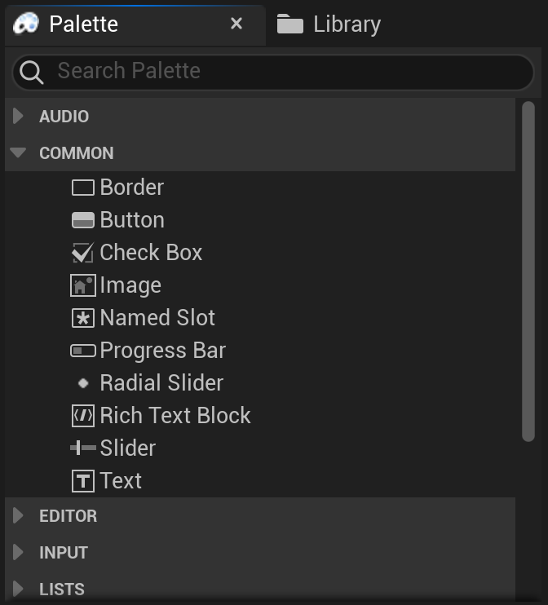
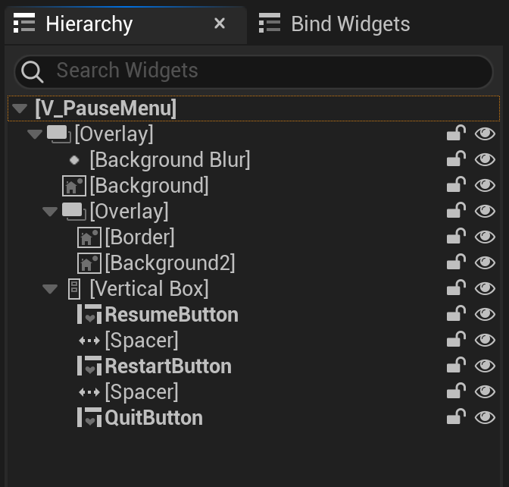
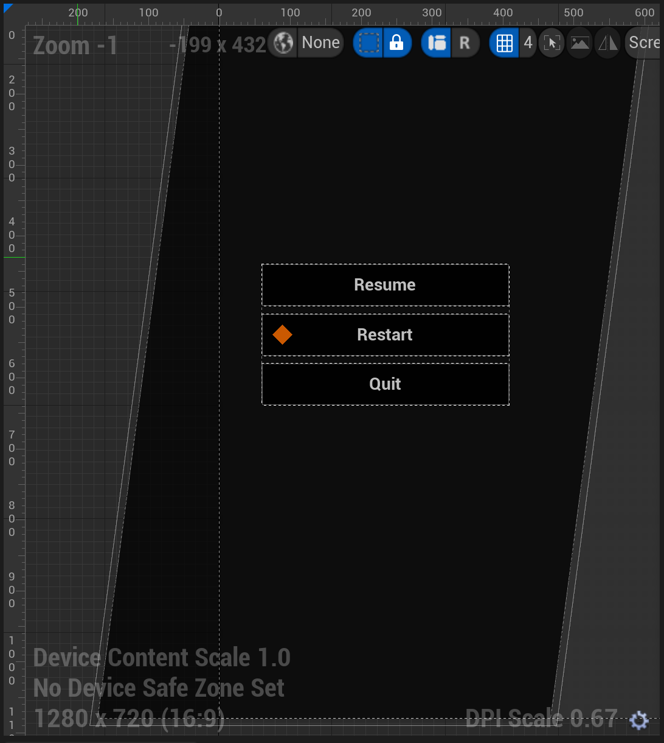
UMG & Designer
Unreal Motion Graphics - Default UI system
Widget vs User Widget

Slide 4
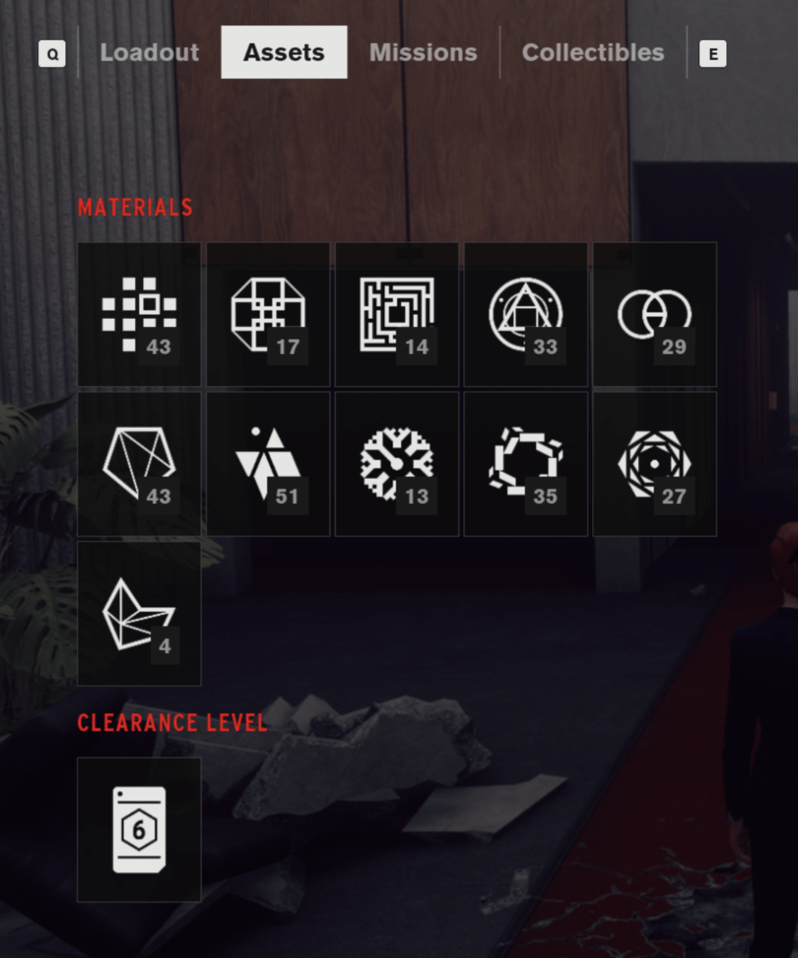
Views
Partition to standalone Views
Unique Identification of each View
View Types for shared behavior
Event Based, no direct access to other Views
Just because two UIs share a common part doesn’t mean they need to be clumped to one View

Slide 5
Activatable Widgets
Need to be able to react to different lifetime events
Register visibility events in Construct
Register visual change events in OnActivated
Clean up your delegates
Should include both C++ functions and Blueprint delegates
Instantiated (game start)
Construct
Opened
On Activated
Optional
Bind Input
Closed
On Deactivated
Destroyed
Destruct

Slide 6
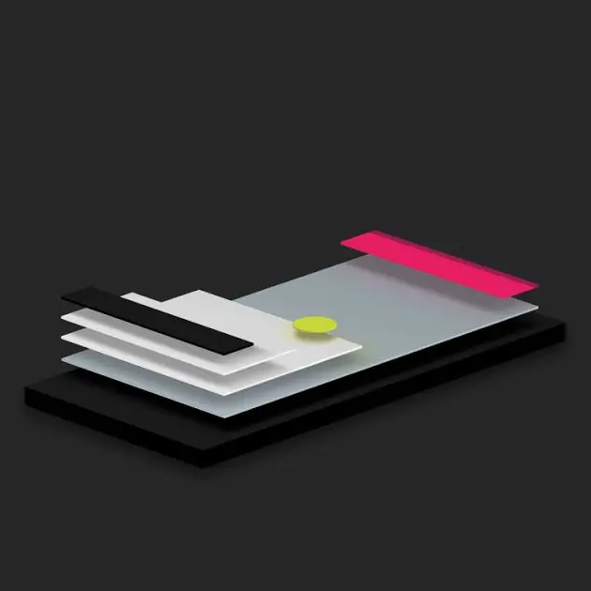
Layers
Grouping of Views
Rendering order
Visibility manipulations
Stacks vs Queues
99% predefined
Use of Layer Widget

Slide 7
UI Management
Automates processes
Contains current state of UI
Pushes Views on screen
Only manager can manipulate Views
Should be “black box” feature, doesn’t need to bother you when coding Views themselves
Can be configurable for different levels
Can be implemented either through Subsystem or HUD Actor

Slide 8
UI Part II
Daniel Janák

Slide 9
Content of this lecture
Focus
Layouts
Component Widgets
UI Materials
Input

Slide 10
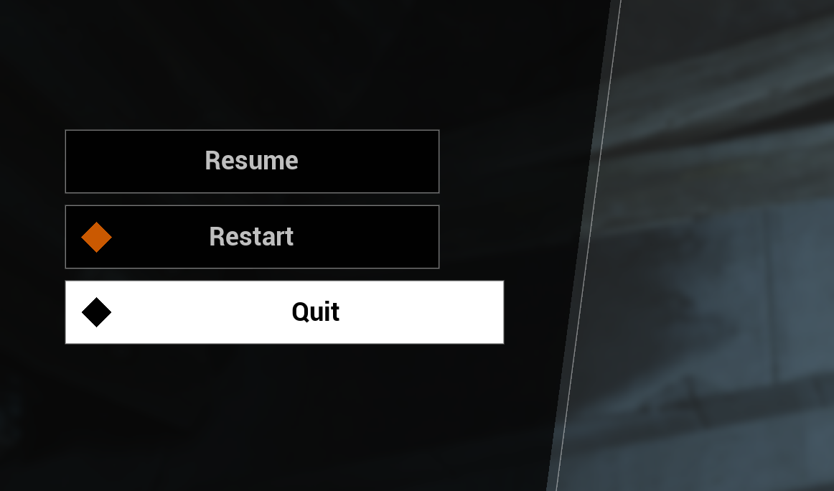
Focus
Core mechanism behind UI navigation
Only one focused widget at a time
Focus vs Hover

Slide 11
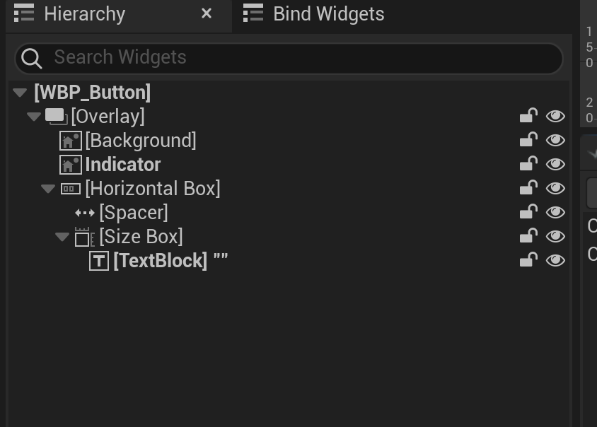
Layouts and Components
Basic layouting
Performance hits
Reusable Widget Components
Logical Widget Components

Slide 12
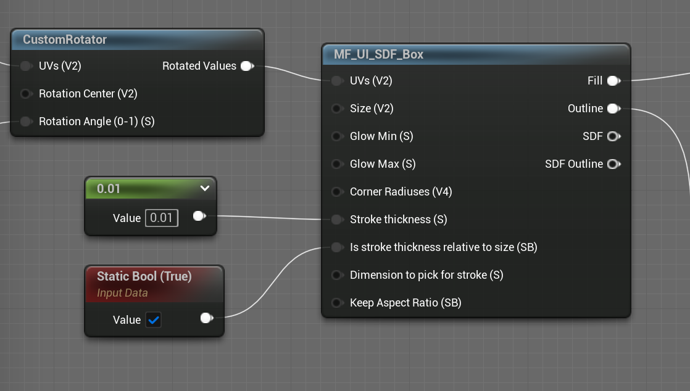
UI Materials
Why we use materials in UI
Material Lab
Basic Example

Slide 13
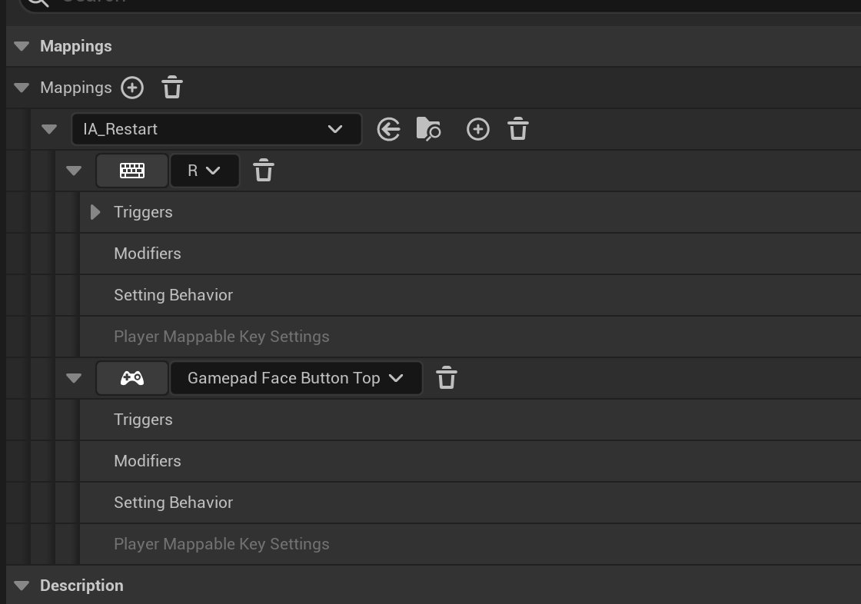
Input
Enhanced Input System
Input Routing
Registering Input

Slide 14
Additional Resources
UI Material Use
Basic Optimizations
CommonUI Overview
CommonUI Tutorial

